Slide 1
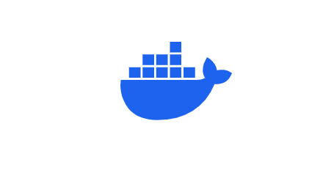
Docker

Slide 2
Concepts
What is Docker?
Why Docker?
How does Docker Works?
Architecture
Docker Image
Docker Containers
Installation
Commands
Short Cuts
Docker – real life development process

Slide 3
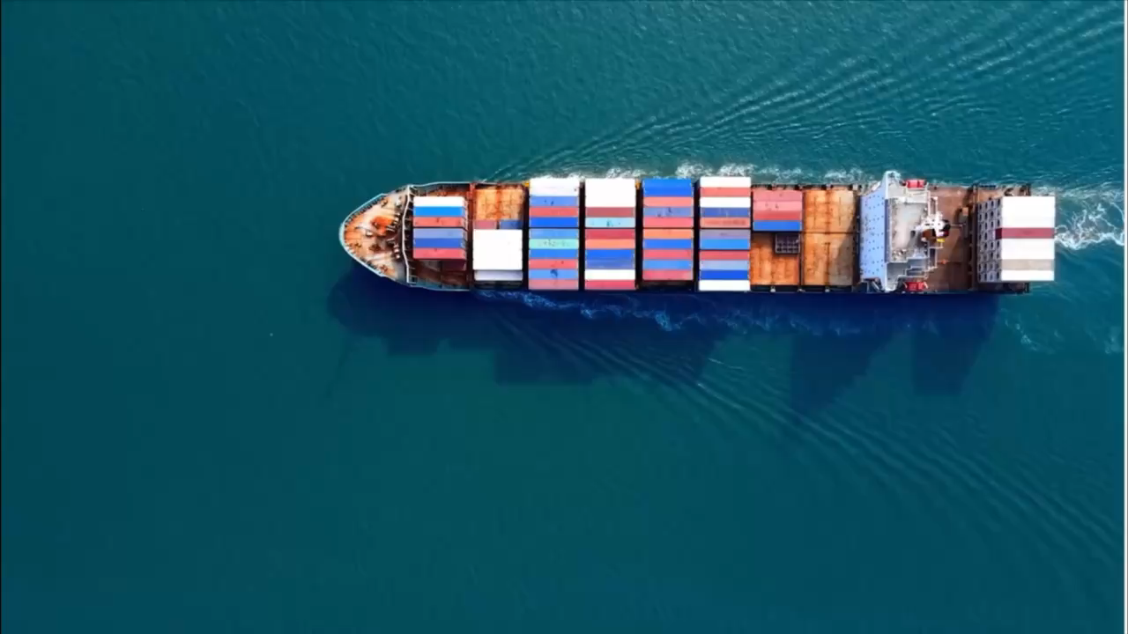
What is Docker?

Slide 4
What is Docker & Why we use?

Slide 5
What is Docker & Why we use?
It is a platform for building, running, and shipping applications in a consistent manner.
Why?
One or more files missing.
Software version mismatch.
Different configuration settings.

Slide 6
Why Docker?

Slide 7
Why Docker?
It offers portability, consistency, and scalability for deploying applications in different environments.
Portability: Docker images can be run on any operating system, making it easy to deploy applications to different environments.
Consistency: Docker containers provide a consistent environment for applications to run in. This means that developers can be confident that their applications will work the same way on any machine that they are run on.
Scalability: Docker containers can be easily scaled up or down, making it easy to manage applications with varying workloads.

Slide 8
How does Docker Works?

Slide 9
How does Docker Works?
Docker uses a client-server architecture. The Docker client talks to the Docker daemon, which does the heavy lifting of building, running, and distributing your Docker containers.
The Docker client and daemon can run on the same system, or you can connect a Docker client to a remote Docker daemon.

Slide 10
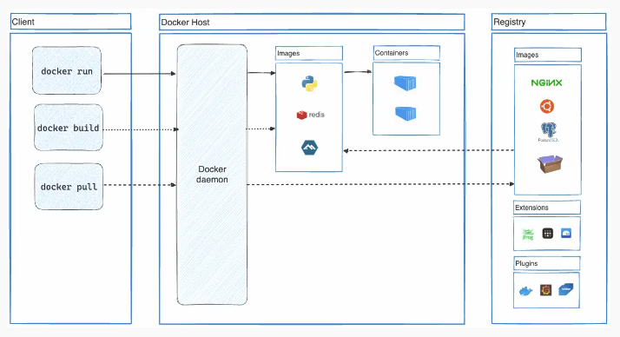
Architecture

Slide 11
Docker Image

Slide 12
Docker Image
A Docker image is a read-only template containing a set of instructions for creating a container that can run on the Docker platform.

Slide 13
Docker Containers

Slide 14
Docker Containers
A container is a standard unit of software that packages up code and all its dependencies so the application runs quickly and reliably from one computing.

Slide 15
Installation
Link: https://hub.docker.com/
Docker is available for Windows, Mac, and Linux.
Initially, docker was created only for Linux OS but later docker was developed for Windows and Mac OS’s.

Slide 16
Commands
If any new joiner joins your team they do not need to install all the setups they just use the below command.
docker-compose up
It will download and run all the required installations and configurations on their machines.
If you just want to remove all the unwanted installations and configurations in your machine use the below command to remove.
docker-compose down – rmi all

Slide 17
List of images we have locally?
C:\Users\ShaikSri>docker images
To pull the image use the below command,
C:\Users\ShaikSri>docker pull mongo
To pull the containers use the below command,
C:\Users\ShaikSri>docker run mongo
List of containers we have locally?
C:\Users\ShaikSri>docker ps
Use Ctrl+C to exit the cmd process.

Slide 18
By using the ‘-d’ or ‘-detach’ it runs containers in the background and prints the counter ID.
C:\Users\ShaikSri>docker run -d nginx:1.25
Docker logs {container} = View logs from the service running inside the container (Which are present at the time of execution).
C:\Users\ShaikSri>docker logs 3280564c35fc
We can run Containers without pulling the image. (Shortcut)
C:\Users\ShaikSri>docker run redis:6.0-alpine
Docker stop {container} = stop one or more running containers
C:\Users\ShaikSri>docker stop 9abf501d070f

Slide 19
By using -p or –publish = Publish a container’s port to the host
C:\Users\ShaikSri>docker run -d -p 8000:80 nignx
By using -a or -all = list of all containers (stopped and running)
C:\Users\ShaikSri>docker ps -a
By using this command, we can run the stopped containers. docker start {container}
C:\Users\ShaikSri>docker start 7118acdad979
We can add names to our containers.
C:\Users\ShaikSri>docker run --name sri-sk -d nginx
By using name also, we can find logs
C:\Users\ShaikSri>docker logs sri-sk

Slide 20
Short Cuts
Build - Build an image from a Dockerfile
History - Show the history of an image
Import - Import the contents from a tarball to create a filesystem image
Inspect - Display detailed information on one or more images
Load - Load an image from a tar archive or STDIN
Ls - List images
Prune - Remove unused images
Pull - Download an image from a registry
Push - Upload an image to a registry
rm - Remove one or more images
save - Save one or more images to a tar archive (streamed to STDOUT by default)
tag - Create a tag TARGET_IMAGE that refers to SOURCE_IMAGE

Slide 21
Docker – real life development process

Slide 22
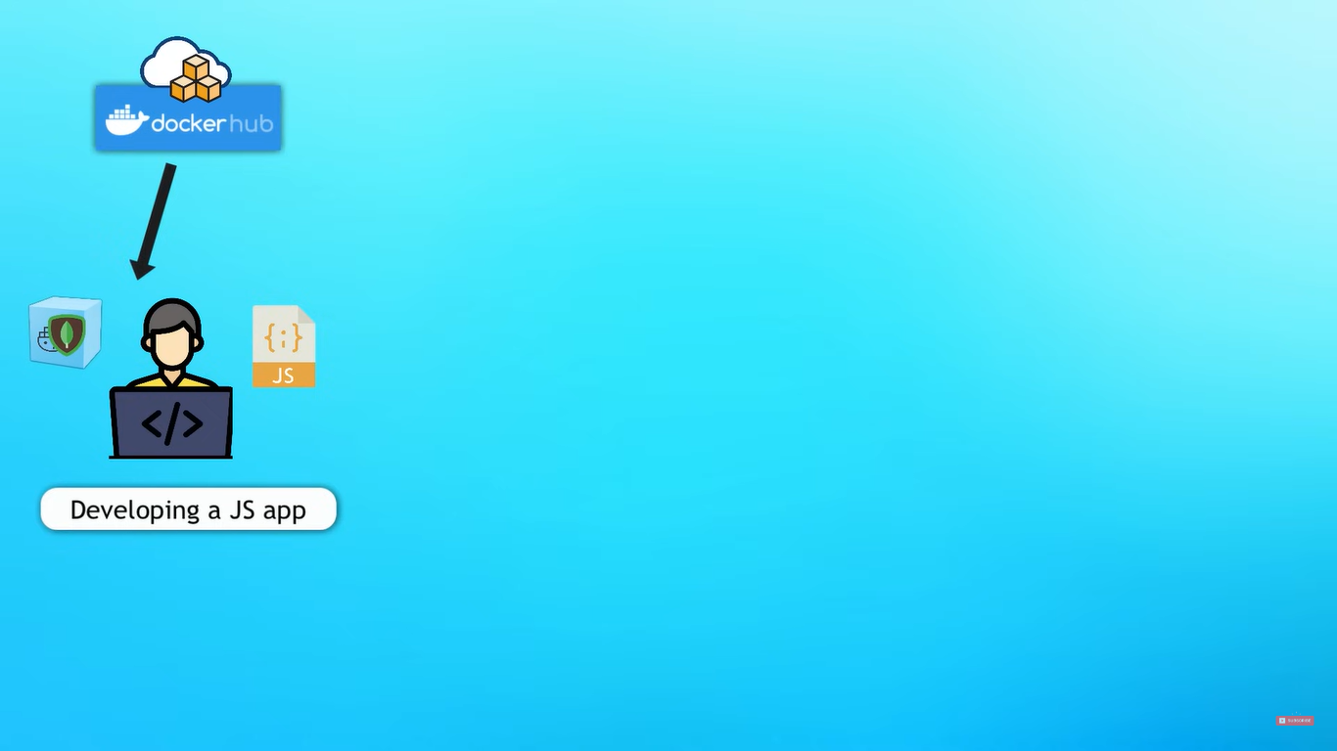

Slide 23
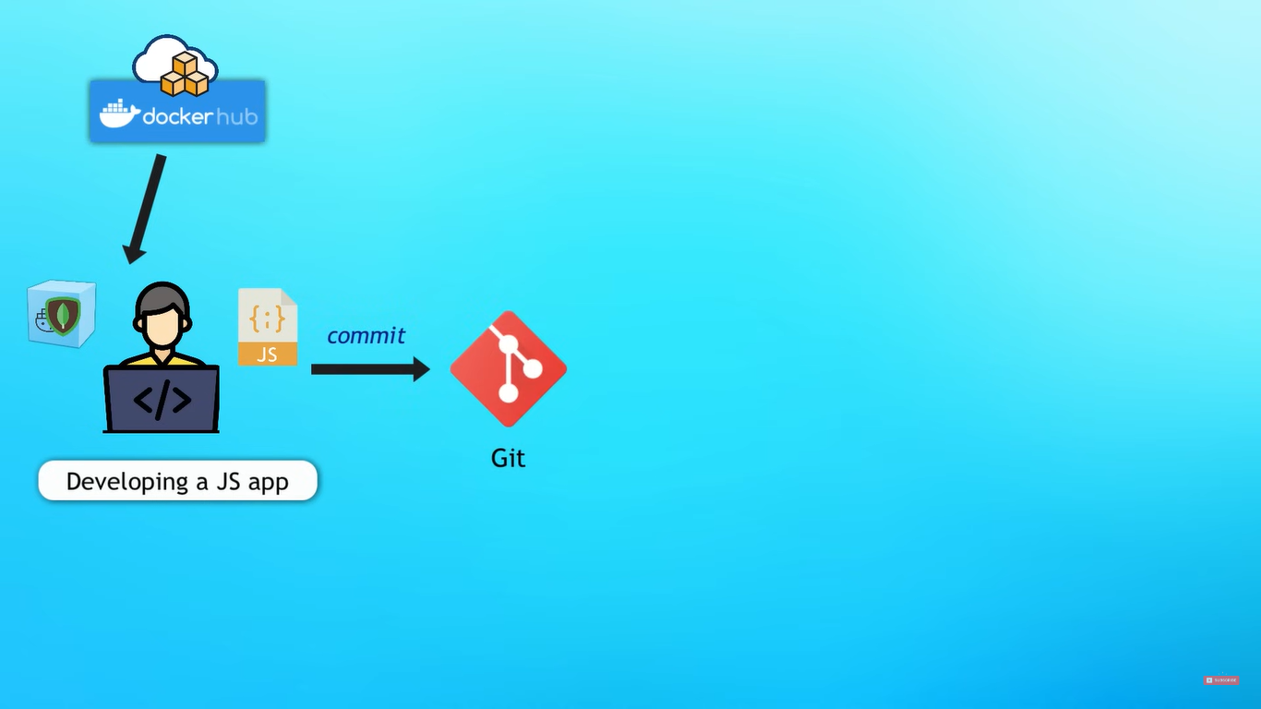

Slide 24
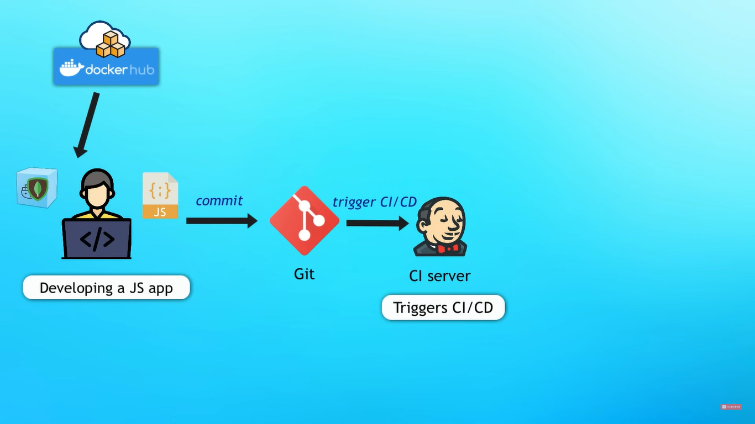

Slide 25
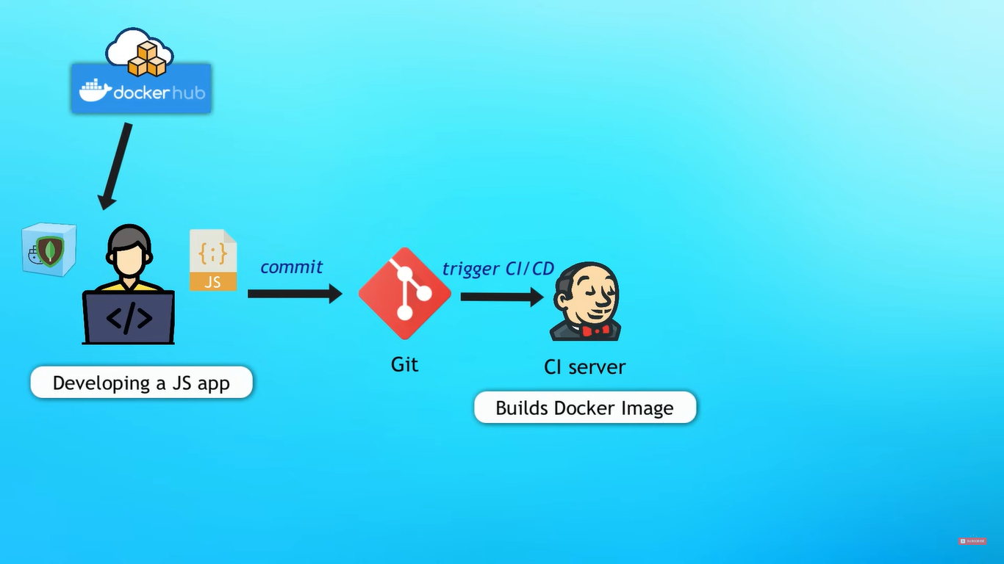

Slide 26
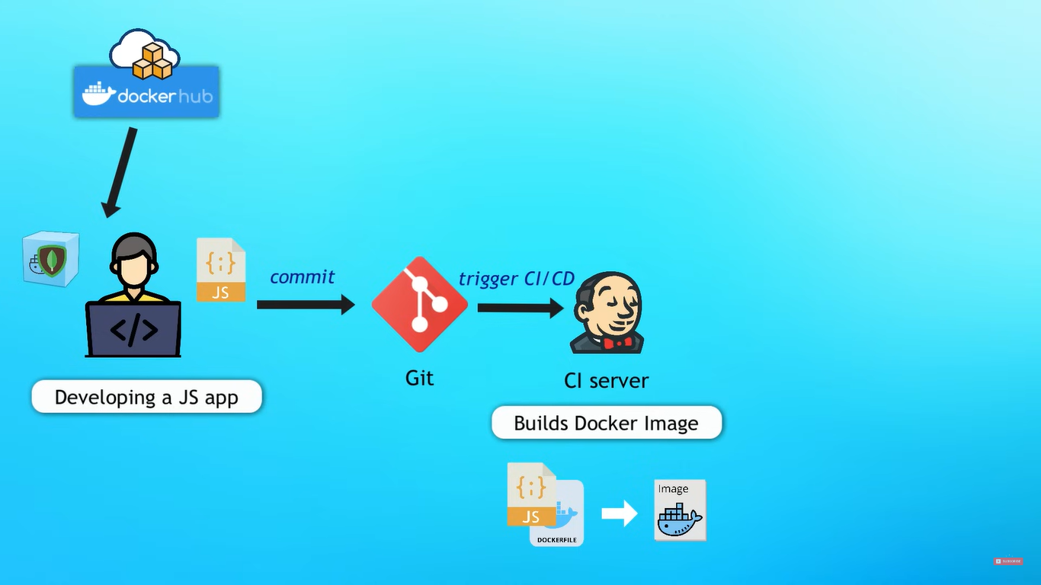

Slide 27
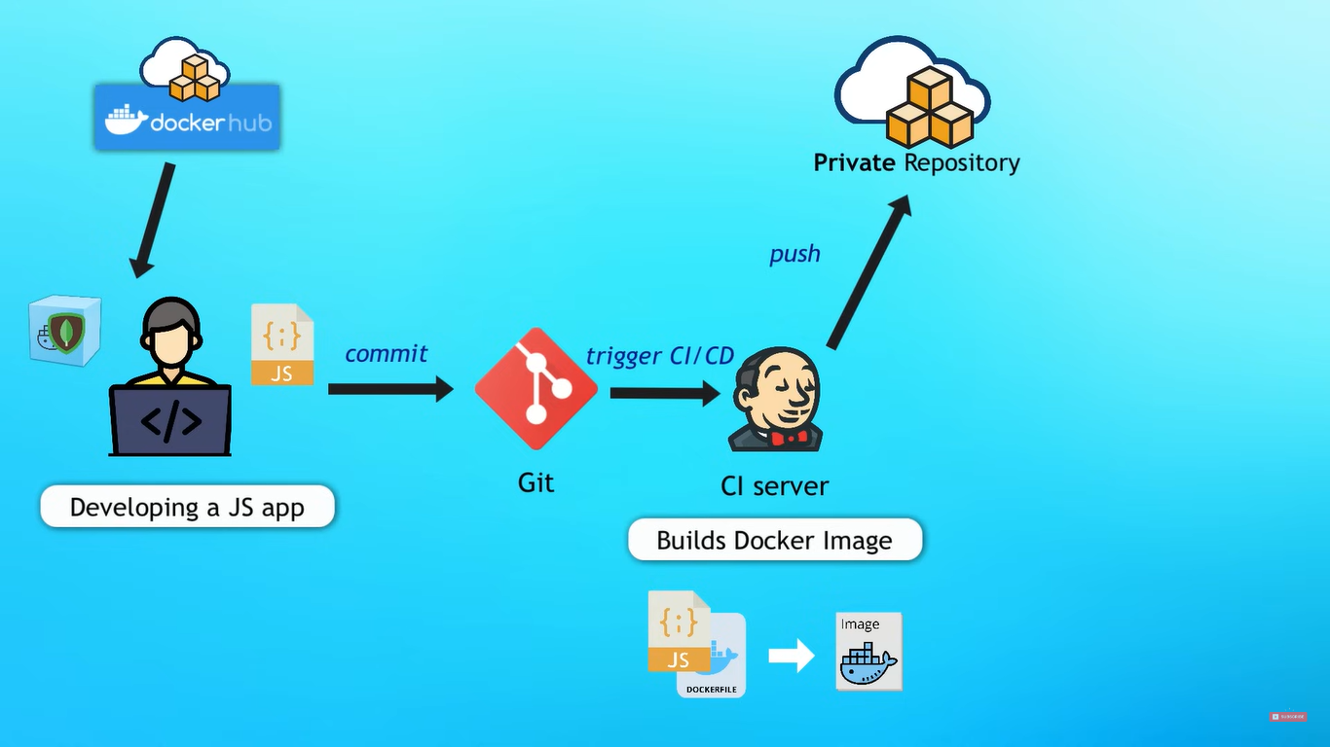

Slide 28
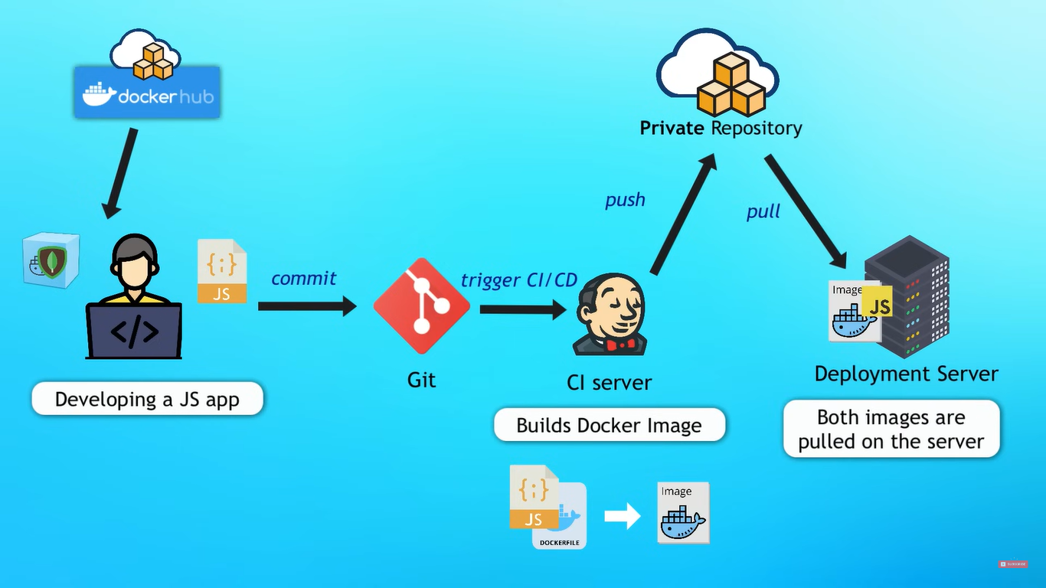

Slide 29
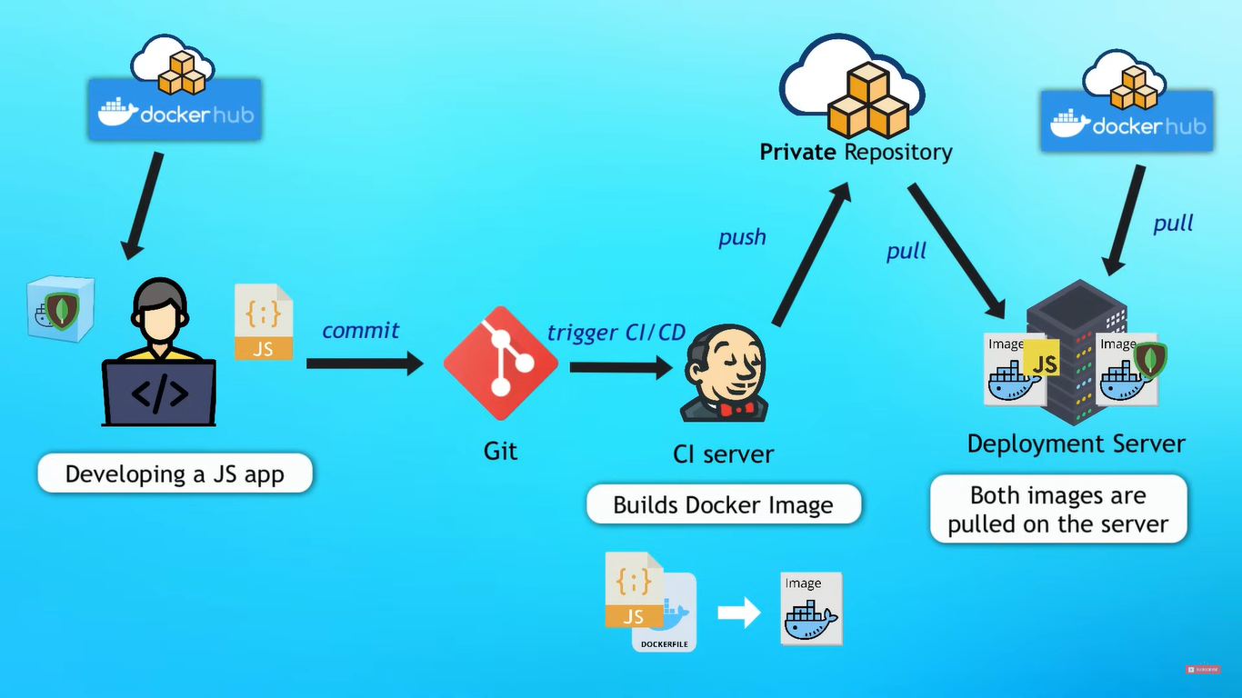

Slide 30

Docker – real life development process

Slide 31
Documents & YouTube Videos
https://www.youtube.com/watch?v=pg19Z8LL06w (Short Course)
https://www.youtube.com/watch?v=3c-iBn73dDE&t=17s (Full Course)

Slide 32
Thank You…!!!
Srimanth Shaik

